Slide 1
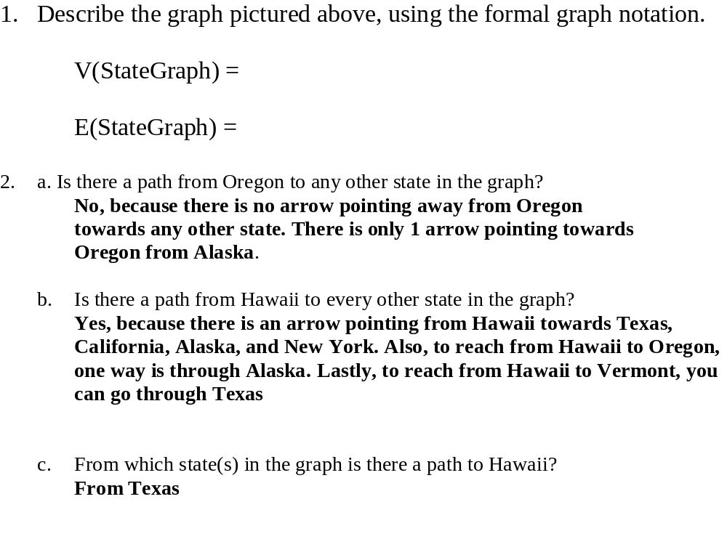
CS204
Myers
V(StateGraph) = {Oregon, Alaska, Texas, Hawaii, Vermont, NewYork, California}
E(StateGraph) = {(Alaska, Oregon), (Hawaii, Alaska), (Hawaii, Texas), (Texas, Hawaii), (Hawaii, California), (Hawaii, New York), (Texas, Vermont), (Vermont, California), (Vermont, Alaska)}
1. Draw the StateGraph
Oregon
Alaska
Texas
Hawaii
California
Vermont
New York

Slide 2
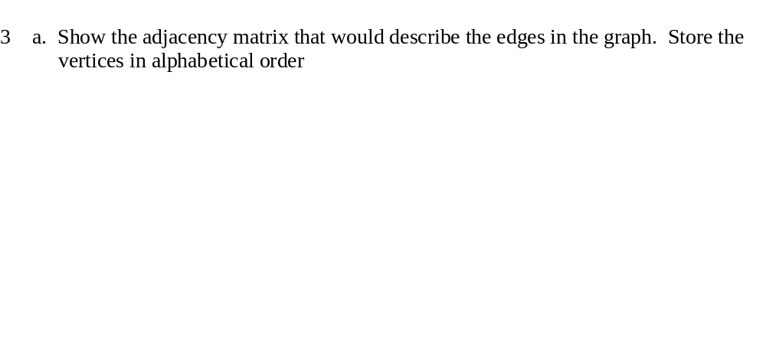
States
AK CA HI NY OR TX VT
Alaska
California
Hawaii
New York
Oregon
Texas
Vermont
0 | 0 | 0 | 0 | 1 | 0 | 0
0 | 0 | 0 | 0 | 0 | 0 | 0
1 | 1 | 0 | 1 | 0 | 1 | 0
0 | 0 | 0 | 0 | 0 | 0 | 0
0 | 0 | 0 | 0 | 0 | 0 | 0
0 | 0 | 1 | 0 | 0 | 0 | 1
1 | 1 | 0 | 0 | 0 | 0 | 0
3. b. Show the adjacency lists that would describe the edges in the graph
Alaska
California
Hawaii
New York
Oregon
Texas
Vermont
OR
null
null
AK
CA
NY
TX
null
null
null
HI
VT
null
AK
CA
null

Slide 3
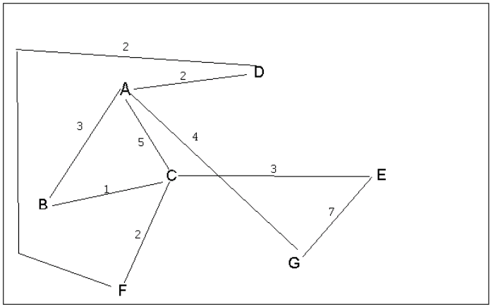
4 a. Which of the following lists the graph nodes in depth first order beginning with E?
A) E, G, F, C, D, B, A
B) G, A, E, C, B, F, D
C) E, G, A, D, F, C, B
D) E, C, F, B, A, D, G
4 b. Which of the following lists the graph nodes in breadth first order beginning at F?
A) F, C, D, A, B, E, G
B) F, D, C, A, B, C, G
C) F, C, D, B, G, A, E
D) a, b, and c are all breadth first traversals

Slide 4
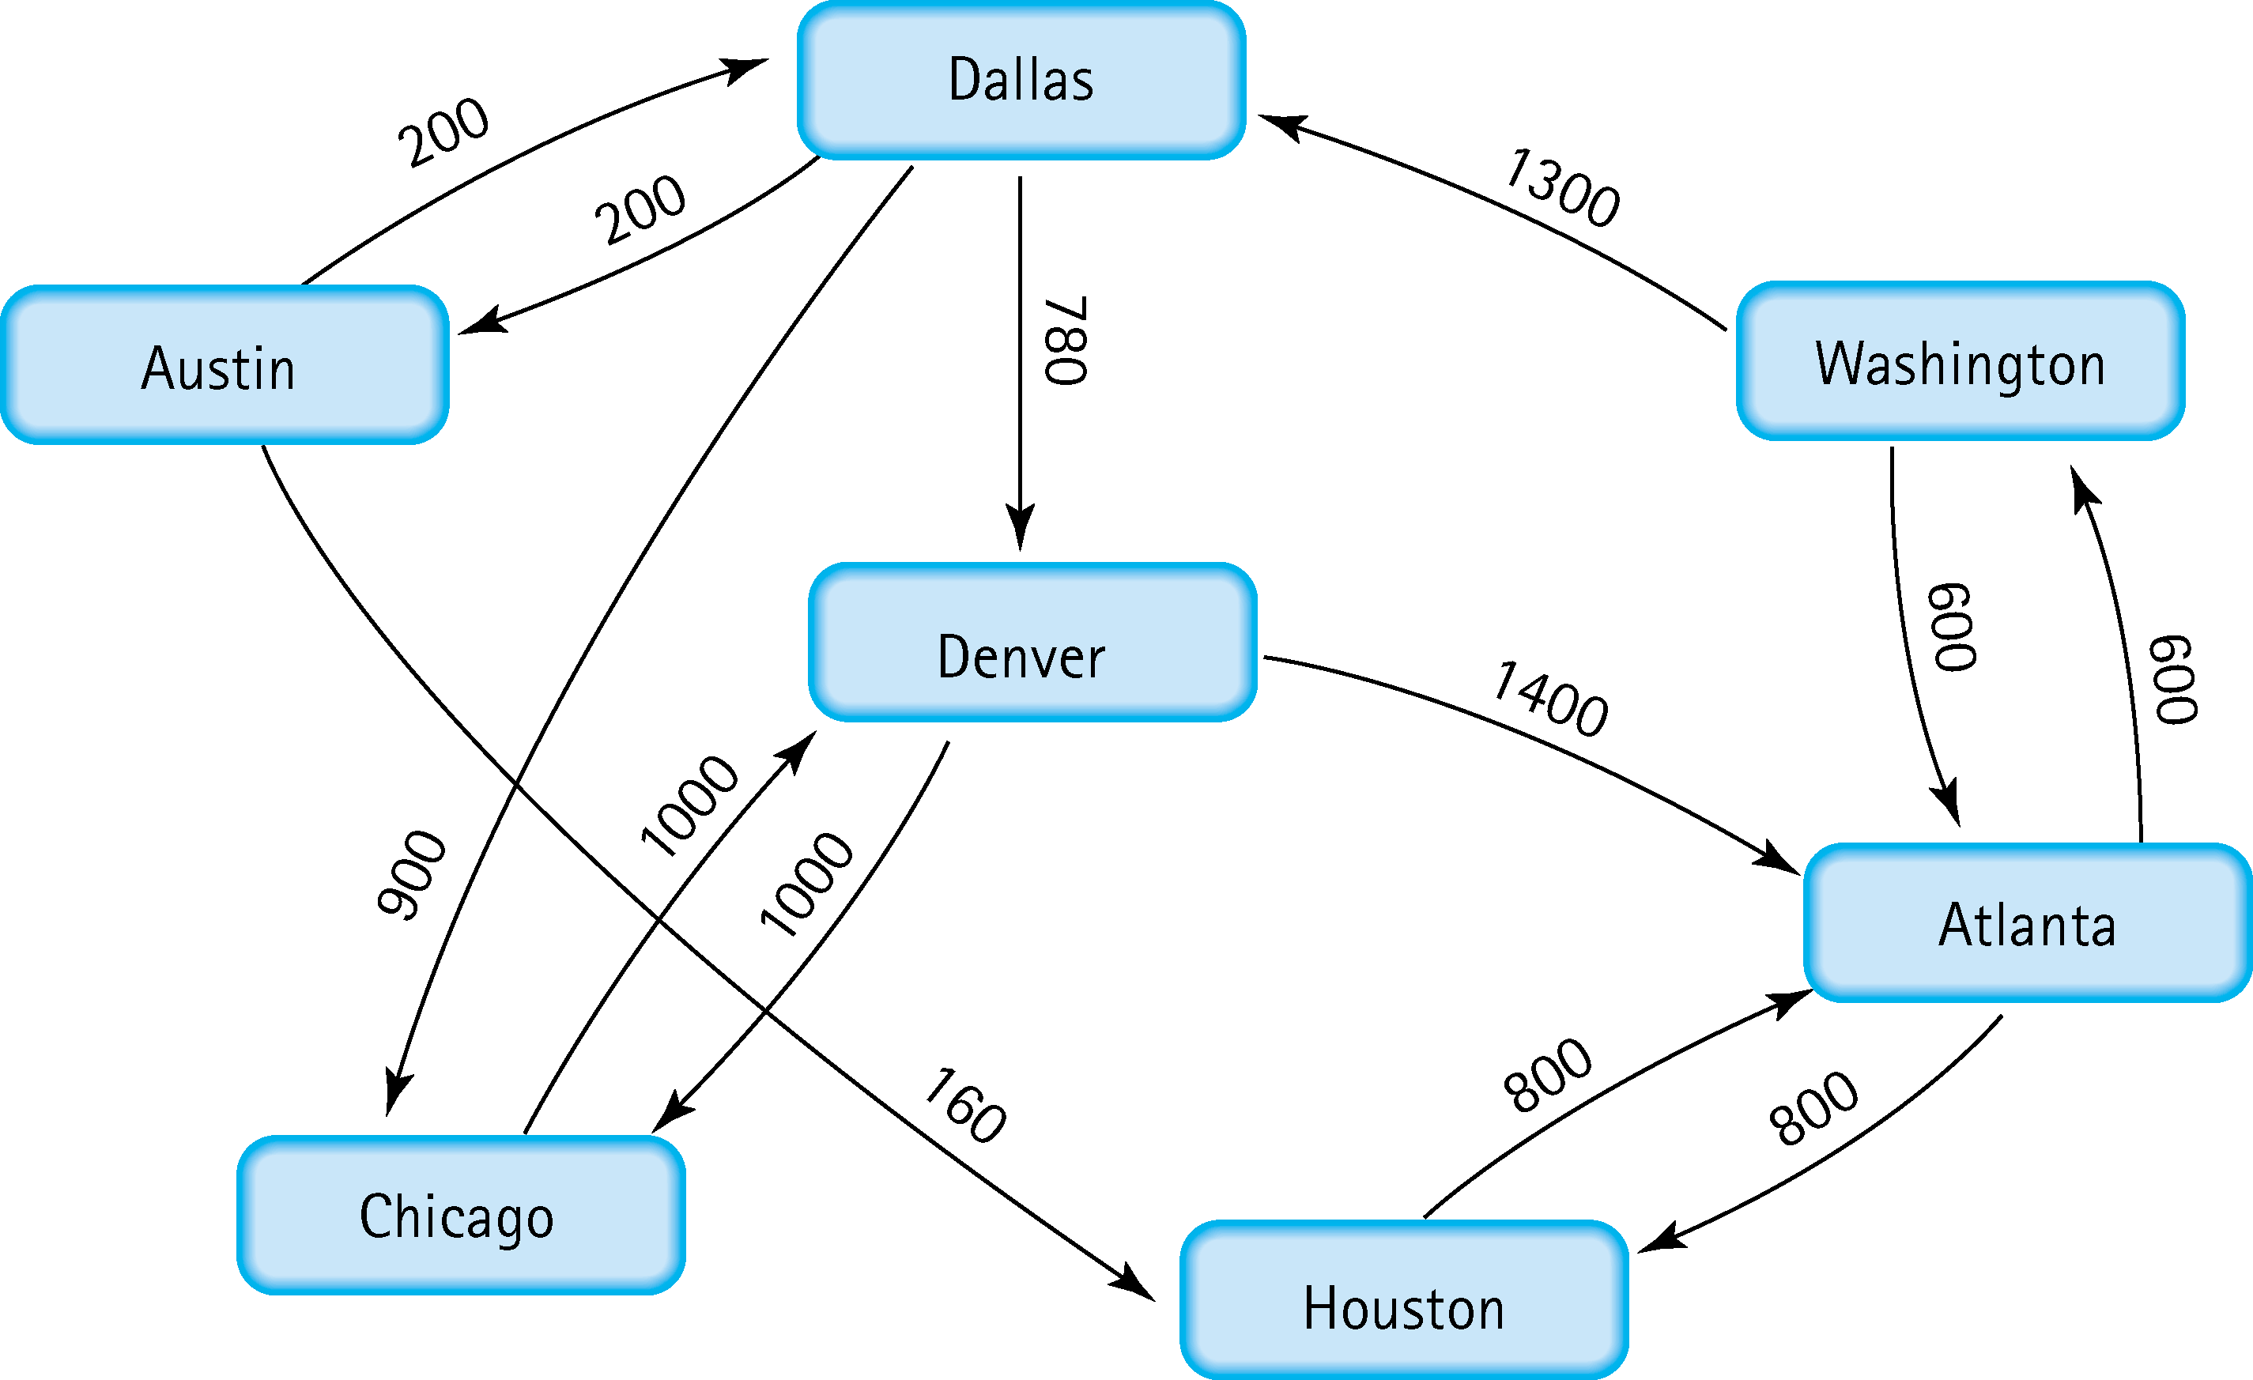
Find the shortest distance from Atlanta to every other city
Atlanta to Washington
Shortest Distance = 600
Atlanta to Houston
Shortest Distance = 800
Atlanta to Dallas
(Atlanta to Washington) + (Washington to Dallas)
600 + 1300
Shortest Distance = 1900
Atlanta to Austin
(Atlanta to Washington) + (Washington to Dallas) + (Dallas to Austin)
600 + 1300 + 200
Shortest Distance = 2100
Atlanta to Denver
(Atlanta to Washington) + (Washington to Dallas) + (Dallas to Denver)
600 + 1300 + 780
Shortest Distance = 2680
Atlanta to Chicago
(Atlanta to Washington) + (Washington to Dallas) + (Dallas to Chicago)
600 + 1300 + 900
Shortest Distance = 2800

